Slide 1
RxJS
RxJS Terms and Syntax
Lecture 3
By James(Jin) Wang
12/05/2021

Slide 2
Outline
Observer/Subscriber
Observable stream
Starting the Observable stream/Subscription
Stopping the Observable stream
Creation functions

Slide 3
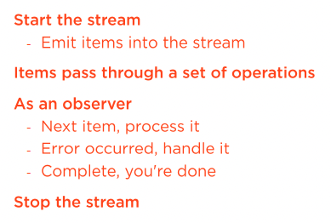
Processing Observable Stream

Slide 4
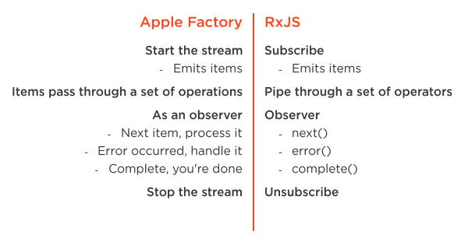
Processing Observable Stream

Slide 5
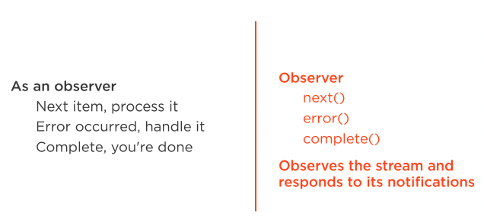
Observer

Slide 6
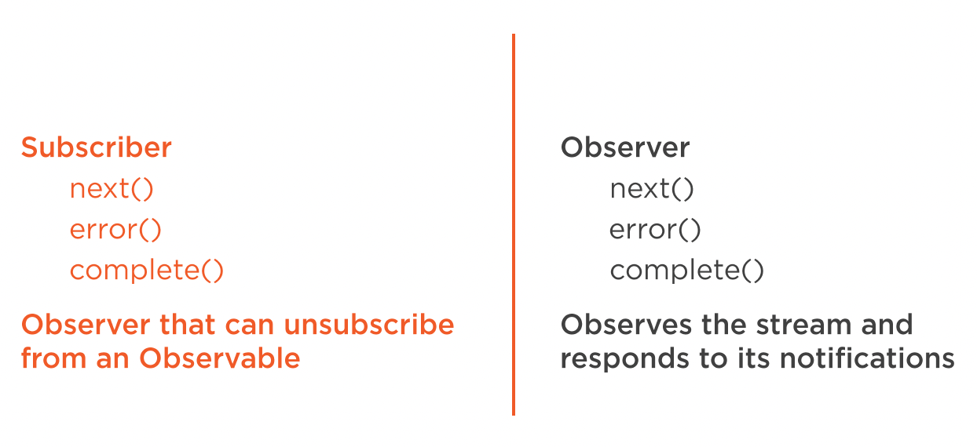
Subscriber

Slide 7
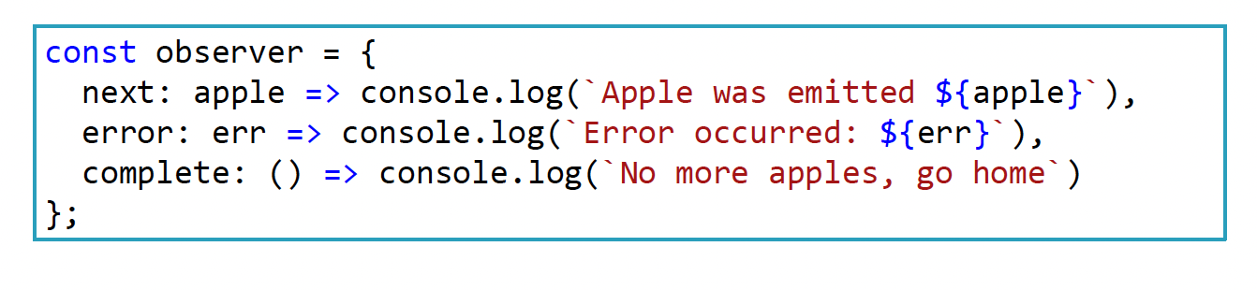
Observer

Slide 8
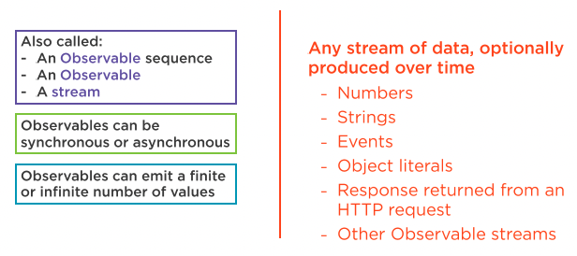
Observable Stream

Slide 9
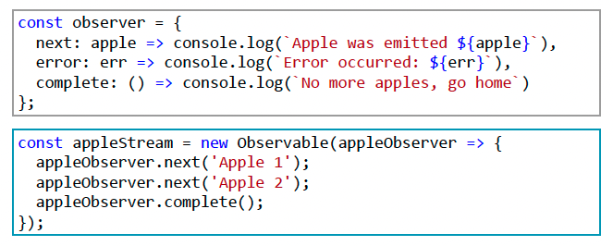
Observable

Slide 10
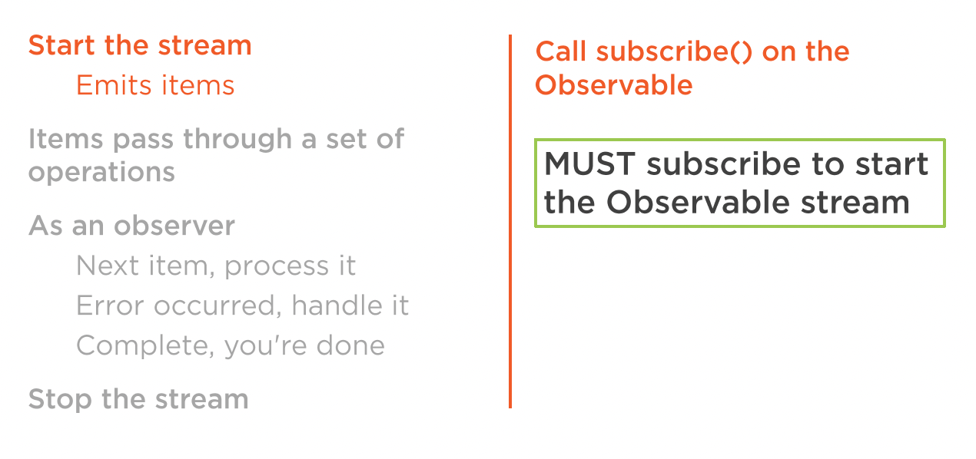
Subscription

Slide 11
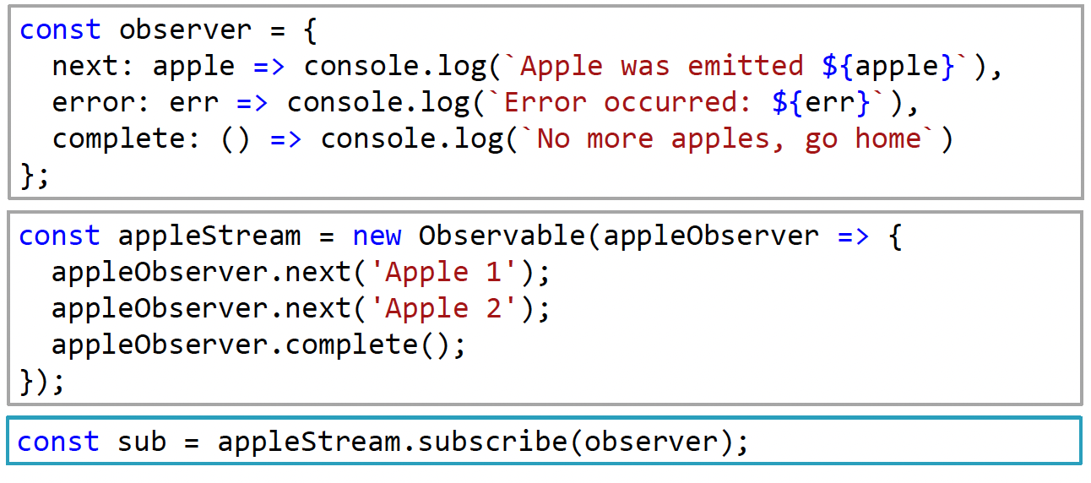
Subscription

Slide 12
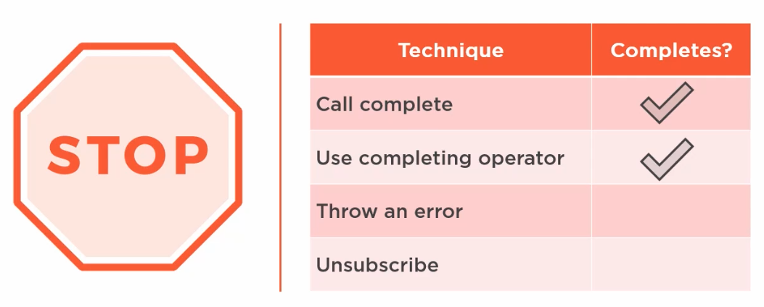
Stop the Stream

Slide 13
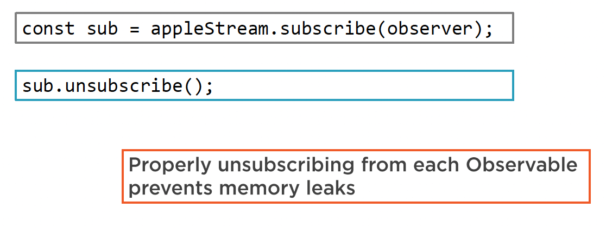
Unsubscribe

Slide 14
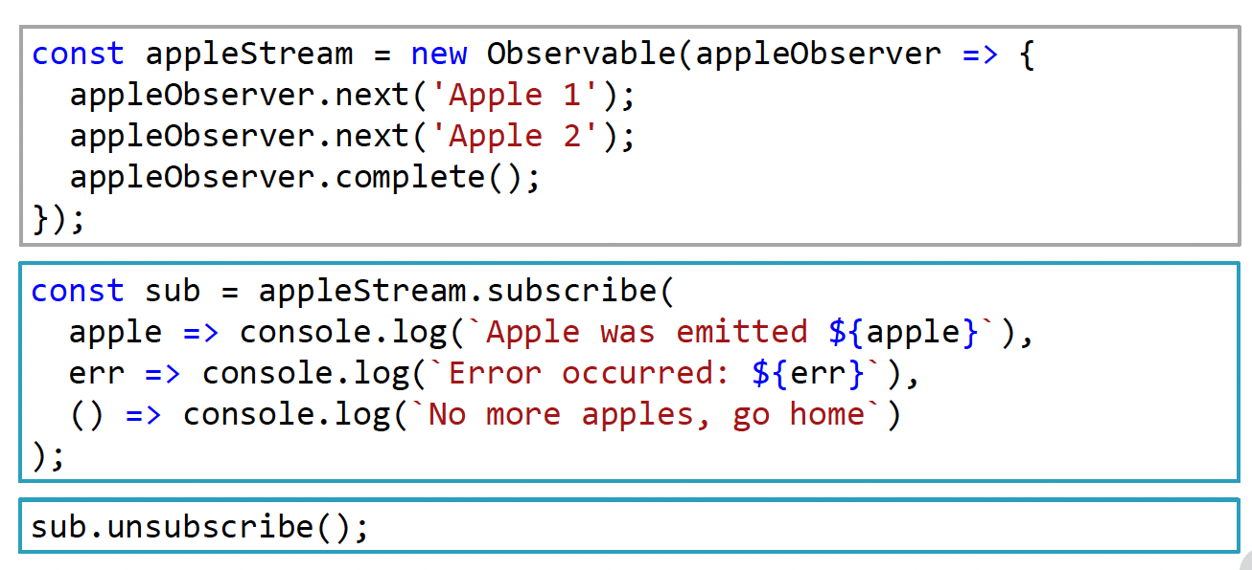
Unsubscribe

Slide 15
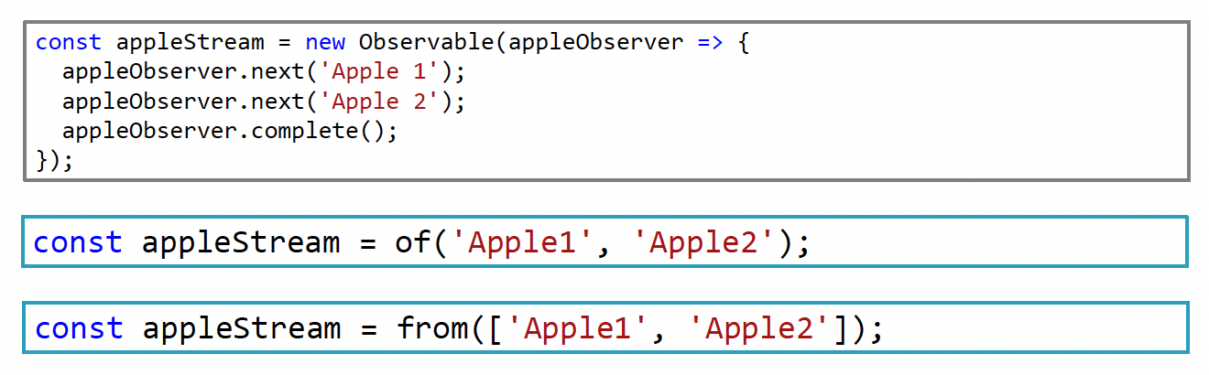
Create an Observable

Slide 16
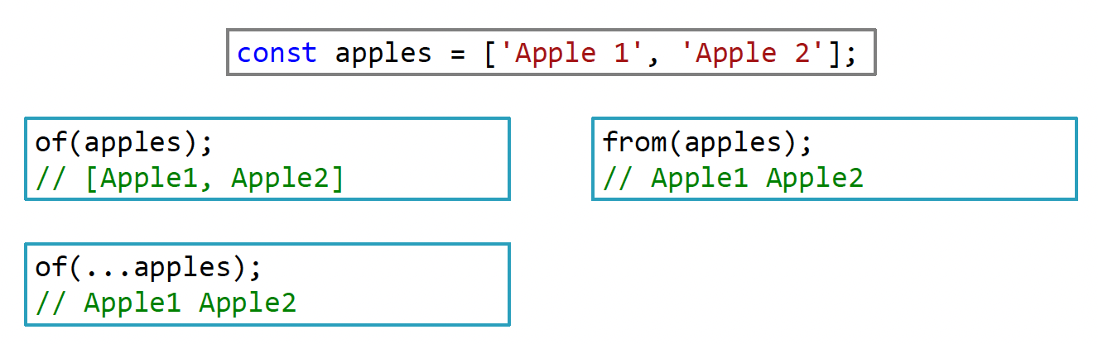
of VS from

Slide 17
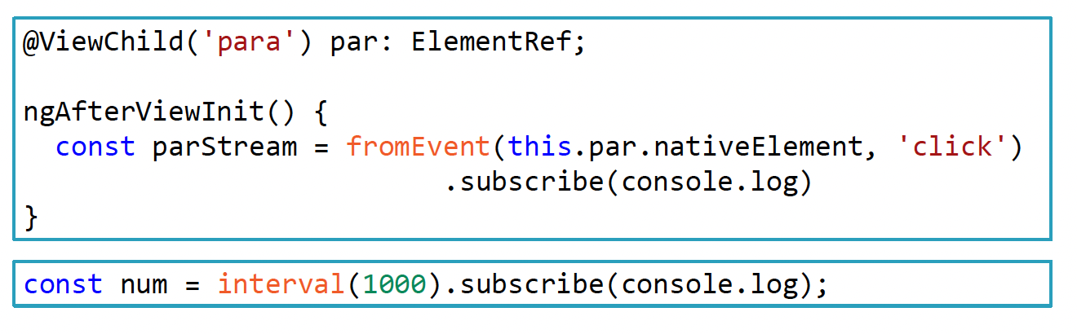
Create an Observable
  Demo: Create Functions

Slide 18
Summary

Slide 19
Assignment

Slide 20
Self Study
  RxJS: The Big Picture
  https://app.pluralsight.com/library/courses/rxjs-big-picture

